Slide 1
Sequence Assembly
modified from: Jeff de Wet

Slide 2
Learning Objectives
To gain knowledge on underlying strategies for genome assembly
To learn how to work in graph-based structures

Slide 3
Sequence Assembly is a Graph Problem
Goal: Reconstruct a long sequence from a set of shorter sequences, the "reads"
Graph – nodes and edges
Nodes contain data (sequence)
Edges connect nodes by some relationship
The lengths of reads are characteristic of the technology used to determine or read the sequence
Sequence is the linear, consecutive order of the 4 bases as found in a nucleic acid
Sanger dideoxy with capillary electrophoreses 700-800 bases per read, very high accuracy
Pyrosequencing (454): ~400 bases per read
Illumina: ~100 bases per read (250 bp more recently)
New long read technologies

Slide 4
Assembly as a Graph Problem
Overlap information is used to construct the layout graph
Nodes of the graph are a collection of sequence reads
Edges are determined by (near) sequence identity between reads – reads have overlaps with one another or are subsequences
Near identity because of errors in sequence reads
Try to find a unique path through the graph that orders and orients the reads – this path will give the sequence of the source DNA
Overlapping sequence data is used to generate a consensus sequence

Slide 5
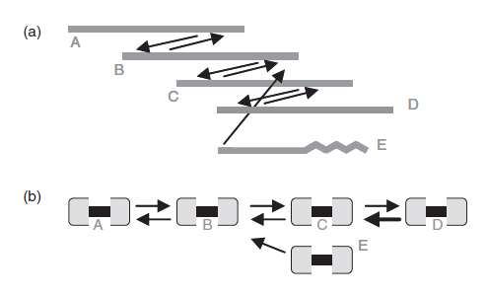
Graph representations of a contig assembly JR Miller et al., Bioinformatics 24: 2818 (2008)
Contig: contiguous sequence constructed by joining reads that have overlapping sequence information
E has identity at only one end, so only leads to inclusion of 3 nodes. Path ABCD includes 4 nodes and is chosen as better path

Slide 6
Repeats – The Challenge to Assembly
Assembly would be relatively straightforward except for the existence of repeated sequences in genomes
Repeats can be exact or can have small variations
Simple sequence repeats such as ACACACACAC… can exist in multiple places and have varying total lengths
Which is the correct length at which location?

Slide 7
Repeats in a graph
Unique sequences bordering repeat
Unique sequences bordering repeat
Read length
A
E
B
F
repeat
C
G
D
H
Paired Read
D'
H'
Unsequenced region of long fragment
D+D'
H+H'
Scaffold, central sequence uncertain
If the repeat is longer than the read length, you can't tell which of the unique sequences on the left should be in a contig with which sequence on the right – this is where large library inserts or mate-pair sequencing approaches can help

Slide 8
An Additional Challenge – Inexact Repeats
ACGTGTTGAGTACGTCGTTGTAACGAGAAAGTGACCGTCTACTA
ACGTGTTGCGTACGTCGTTGTAACG-GAAAGTGACCGTCTACTA
ACGTGTTGCGTACGTCGTTGTAACGAGAAAGTGACCCTCTACTA
ACGTGTTGCGTACGTGGTTGTAACGAGAAAGTGACCGTCTACTA
ACGTGTTGAGTACGTCGTTGTAACGAGAAAGTGTCCGTCTACTA
ACGTGTTGCGTACGTCGTTGTAACGAGAAAGTGTCCGTCTACTA
ACGTGTTGCGTACGTCGTTGTAACGAGAAAGTGACCGTCTACTA
Consensus
The consensus sequence in this case doesn't match any of the actual repeat examples. Note that some of the repeats share some but not all differences from the consensus which adds to the complexity. Consider the difficulty of trying to disentangle ~1,000,000 copies of the Alu repeat in the human genome. So, repeats tend to collapse into a single contig or groups of closely related contigs (such as repeat subfamilies).

Slide 9
New, extremely high throughput sequencing poses challenges to assembly problem
Reads are relatively short, ~100 bases for Illumina – relatively short repeats are a problem
Error rate is higher (.002 - .005 for Illumina, tends to increase further into the read)
Very large number of sequences makes all-by-all comparison of overlap graph approaches impractical
Single lane of HiSeq 2000 run can contain > 10⁸ reads
Need high coverage, >= 30X, to cover genome because of random sampling

Slide 10
DBG – de Bruijn Graph Assemblers
These were developed to work with the shorter reads such as those produced by the Illumina platform
The problem – massive numbers of reads makes the all-versus-all overlap discovery phase of the OLC assemblers too expensive computationally
N² process
Use of a de Bruijn graph dates back to 1995
R.M. Idury and M.S Waterman (1995) A new algorithm for DNA sequence assembly., J. Comput. Biol. 2: 291-306.

Slide 11
A de Bruijn graph consists of strings of length k
k-mers
Each successive node overlaps the previous node by k-1 characters
As you travel through the graph, each node extends the represented string by one additional character
The path is simple as long as there is only one k-mer that can extend the graph
Again, repeats create the major challenge as they introduce branches into the graph

Slide 12
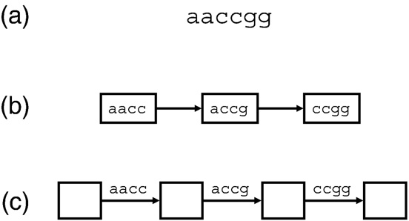
Sequences in a de Bruijn graph can be represented as nodes or as edges connecting nodes JR Miller et al., Bioinformatics 24: 2818 (2008)
Fig. 1. A read represented by K-mer graphs. (a) The read is represented by two types of K-mer graph with K=4. Larger values of K are used for real data. (b) The graph has a node for every K-mer in the read plus a directed edge for every pair of K-mers that overlap by K-1 bases in the read. (c) An equivalent graph has an edge for every K-mer in the read and the nodes implicitly represent overlaps of K-1 bases. In these examples, the paths are simple because the value K=4 is larger than the 2 bp repeats in the read. The read sequence is easily reconstructed from the path in either graph.

Slide 13
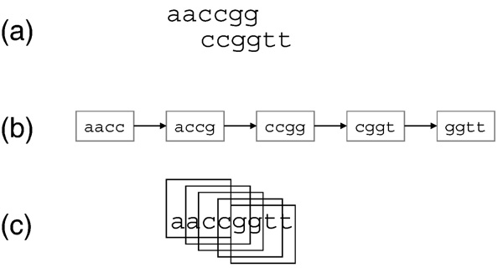
de Bruijn graph connects reads that have k-mers in common JR Miller et al., Bioinformatics 24: 2818 (2008)
Fig. 2. A pair-wise overlap represented by a K-mer graph. (a) Two reads have an errorfree overlap of 4 bases. (b) One K-mer graph, with K=4, represents both reads. The pair-wise alignment is a by-product of the graph construction. (c) The simple path through the graph implies a contig whose consensus sequence is easily reconstructed from the path.

Slide 14
Note:
In the previous two slides, they show only a single strand of sequence. In reality, you need to consider both a k-mer and its reverse complement. Why – you don't know the orientation of sequence reads relative to each other, so you must consider both strands.

Slide 15
Why de Bruijn Graphs?
Platforms such as Illumina's generate huge numbers of short reads, all-versus-all comparison prohibitively expensive
Representing the data as k-mers gives a large reduction in the representation of the data
No matter how many times a k-mer is encountered in the reads, it is represented once in the graph (count information is kept)
For unique regions of sequence, the assembly is constructed by a simple traversal of the connected k-mer nodes

Slide 16
Real data complications
Sequencing errors – introduce frayed ends or bubbles into the graph
One solution – trim ends and pop bubbles if they are represented by one or a low number of k-mers
Repeats – introduce alternate paths into the graph
Repeats, if perfect, collapse into a single representation that connect multiple unique regions
If imperfect, the repeats themselves introduce a complex structure of bubbles and alternative paths
One solutions – break contigs where they encounter repeats so you get unique sequence contigs and repeat contigs

Slide 17
Another approach that some programs use is to remove singleton or low frequency k-mers from the data set before constructing the de Bruijn graph in order to simplify later processing of the graph
This works because the sequence data represents many copies of the source genome – total sequence in the data may represent 50x or greater coverage
Sequencing errors are presumed to be random

Slide 18
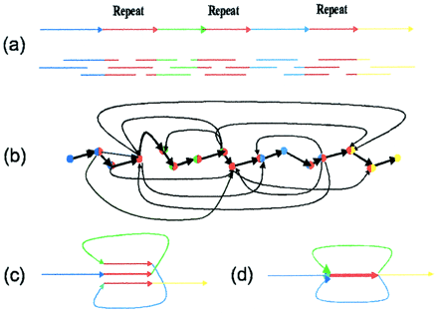
Gluing repeats
(a) DNA sequence with a triple repeat R; (b) the layout graph; (c) construction of the de Bruijn graph by gluing repeats; (d) de Bruijn graph.
P.A. Pevzner et al (2001) Proc. Natl. Acad. Sci. U. S. A. 98 9748–9753.

Slide 19
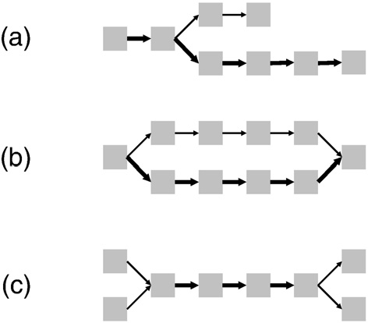
Using k-mer read frequency to simply graphs JR Miller et al., Bioinformatics 24: 2818 (2008)
Trim "tips" or "spurs"
Fig. 3. Complexity in K-mer graphs can be diagnosed with read multiplicity information. In these graphs, edges represented in more reads are drawn with thicker arrows. (a) An errant base call toward the end of a read causes a “spur” or short dead-end branch. The same pattern could be induced by coincidence of zero coverage after polymorphism near a repeat. (b) An errant base call near a read middle causes a “bubble” or alternate path. Polymorphisms between donor chromosomes would be expected to induce a bubble with parity of read multiplicity on the divergent paths. (c) Repeat sequences lead to the “frayed
rope” pattern of convergent and divergent paths.
"pop" bubbles
Cut branches at repeats identified by high k-mer count

Slide 20
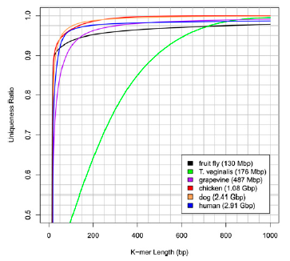
K-mer repeat structure of various genomes Schatz, Delcher & Salzberg (2010) Assembly of large genomes using second-generation sequencing. Genome Research 20: 1165-1173.
Figure 1. The k-mer uniqueness ratio for five well-known organisms and
one single-celled human parasite. The ratio is defined here as the percentage of the genome that is covered by unique sequences of length k or longer. The horizontal axis shows the length in base pairs of the sequences. For example, ~92.5% of the grapevine genome is contained in unique sequences of 100 bp or longer.

Slide 21
From the previous slide, you can see how different k-mer lengths will have different levels of success at overcoming repeats with different genomes
This is for exact k-mer repeats – many genomes have inexact repeats with significantly longer lengths such as SINEs (short interspersed nuclear elements), LINEs (long interspersed nuclear elements), simple sequence and homopolymer regions, endogenous retroviruses and transposable elements
These cause assembly problems, too

